Slide 1
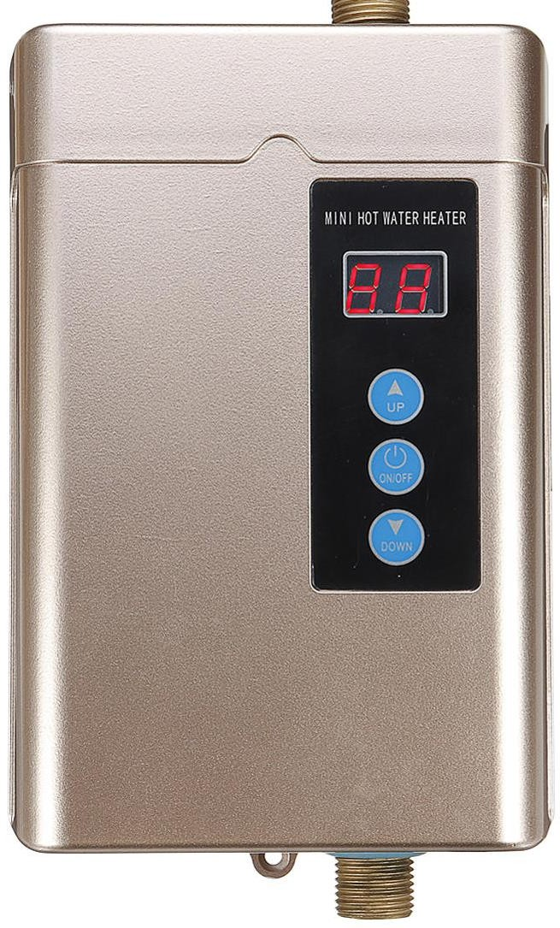
Case Study: Electric Water Heater

Slide 2
Abdelrhman Mosad Abdelhady
ECED up to level 4
Project - >
https://github.com/xMosad/swift_electric_water_heater

Slide 3
Overview
External E2PROM
µC
Up Button
Heating Element
Led
Down Button
Temperature SSD
ON/OFF Button
Heating Element
Temperature
Sensor
Cooling Element

Slide 4
Specifications – Temperature Setting
The “Up” or “Down” buttons are used to change the required water
temperature (set temperature)
The first “Up” or “Down” button press, enters the temperature setting
mode
After entering temperature setting mode, a single “Up” button press
increase the set temperature by 5 degrees
After entering temperature setting mode, a single “Down” button press
decrease the set temperature by 5 degrees
The minimum possible set temperature is 35 degrees
The maximum possible set temperature is 75 degrees
The “External E2PROM” should save the set temperature once set
If the electric water heater is turned OFF then ON, the stored set
temperature should be retrieved from the “External E2PROM”
The initial set temperature is 60 degrees

Slide 5
Specifications – ON/OFF Behavior
If power is connected to the heater, the electric water heater is in OFF
state
If the “ON/OFF” button is released and the electric water heater is in OFF
state, the electric water heater goes to ON state
If the “ON/OFF” button is released and the electric water heater is in ON
state, the electric water heater goes to OFF state
In the OFF state, all display should be turned OFF

Slide 6
Specifications – Temperature Sensing
The temperature sensor measures the water temperature
The water temperature should increase, if the “Heating Element” is ON
The water temperature should decrease, if the “Cooling Element” is ON
Temperature should be sensed once every 100 ms
The decision to turn ON or OFF either the “Heating Element” or the “Cooling Element” based on the average of the last 10 temperature readings

Slide 7
Specifications – Heating/Cooling Elements
The “Heating Element” should be turned ON, if the current water
temperature is less than the set temperature by 5 degrees
The “Cooling Element” should be turned OFF, if the current water
temperature is less than the set temperature by 5 degrees
The “Heating Element” should be turned OFF, if the current water
temperature is greater than the set temperature by 5 degrees
The “Cooling Element” should be turned ON, if the current water
temperature is greater than the set temperature by 5 degrees

Slide 8
Specifications – Seven Segments
2 seven segment by default show the current water temperature or the
set temperature
By default, the 2 seven segment display are show the current water temperature
If the electric water heater is in the temperature setting mode, the 2 seven segment displays should blink every 1 second and show the set temperature
In the temperature setting mode, every change in the set temperature should be reflected on the 2 seven segment displays
The 2 seven segment display should exit the temperature setting mode, if
the “UP” and “Down” buttons are not pressed for 5 seconds

Slide 9
Specifications – Heating Element Led
If the “Heating Element” is ON, the “Heating Element Led” should blink
every 1 second
If the “Cooling Element” is OB, the “Heating Element Led” should be ON

Slide 10
Electric water heater : Static Architecture
External eeprom
Sch_16f
set temp
EEPROM
Up
System state
TEMP
SSD
switchs
DOWN
SSD
On / off
INT0
COOLER
temp_sensor
temp_control
HEATER
Temp sensor
Measured temp
LED

Slide 11
State Machine
Pressed the power button
POWER_OFF
And stay in the while loop
POWER_ON
Timer is on
Scan_switches
If pressed
SETTING_MODE
NORMAL_MODE
If not

Slide 12
Detailed Design
switchs
switch_init
switch_scan
sw_action
Sch_16f
SCH_Init
SCH_Dispatch_Tasks
SCH_Add_Task
SCH_Start
SCH_Stop
temp_control
temp_control_init
temp_set
Led
temp_control_off
SSD
ssd_init
display7s
ssd_update
ssd_blink
ssd_turn_off
temp_sensor
temp_sensor_init
temp_sensor_read
eeprom
EEPROM_init
EEPROM_write
EEPROM_read
get_set_temp

Slide 13
Switchs module
Function | Type
void switch_init(void) | Initialization - initialize the pins direction - Enable external interrupt
void switch_scan(void) | Periodic Task - check every 200 ms if a button was pressed
void sw_action(void) | Global function - if a button is pressed will take the right action responding to it

Slide 14
temp_sensor module
Function | Type
void temp_sensor_init(void) | Initialization - initialize the pins direction - Initialize the adc
uint8_t average (void) | Private function - return the average of the last ten values
uint8_t temp_sensor_read (void) | Periodic Task - read the temp every 100 ms and take average of the last ten values

Slide 15
temp_control module
function | Type
void temp_control_init(void); | Initialization - initialize the pins direction for cooler , heater , led
void temp_set( uint8_t temp ); | Periodic Task - run evry time the ISR fire (1 ms) to keep the temp at the set temp In the normal_mode state
void led(void); | Periodic Task - blink every 1 s if heater is on
void temp_control_off(void); | Global function - turn off cooler , heater , led

Slide 16
SSD module
Function | type
void ssd_init(void) | Initialization - initialize the pins direction
uint8_t display7s(uint8_t v) | Private function - return the right data to be written in the port register
void ssd_update(uint8_t temp) | Periodic Task - update one of the ssd every 20 ms
void ssd_blink(uint8_t e_temp) | Periodic Task - in the setting_mode state blink the ssd every 1 s
void ssd_turn_off(void) | Global function - turn off the SSD

Slide 17
EEPROM
Function | Type
void EEPROM_init(void) | Initialization - initialize the I2C to run eeprom
void EEPROM_write (uint16_t address , uint8_t _x) | Global function - write to a specific address in the EEPROM and is called every time exiting the setting_mode
uint8_t EEPROM_read(uint16_t address ) | Global function -read from specific address called only at the start
void get_set_temp(void) | Global function - one shot task

Slide 18
MCAL
For pic16f877a

Slide 19
I2C DRIVER
Function | operation
void I2C1_Init(uint32_t freq); | Initialize the module with specific frequency
void I2C_Wait(void); | Wait till the right bits get cleared
void I2C1_Start(void); | Send start condition
void I2C1_Stop(void); | Send stop condition
void I2C1_Wr(uint8_t _data); | Write to the I2C bus
uint8_t I2C1_Rd(void); | Read from The I2C bus

Slide 20
ADC DRIVER
function | operation
void ADC_Init(void); | Initialize the adc module
uint16_t ADC_Read (uint8_t channel) | Get the adc value from specific channel

Slide 21
Sch_16f
function | type
void SCH_Init(void); | Initialization - initialize the scheduler for Pic16f877a using timer 1
void SCH_Dispatch_Tasks(void); | Global function - called in the while loop to execute every function at the right time
tByte SCH_Add_Task(void (*) (void), const tWord, const tWord); | Global function - add tasks to scheduler
tByte SCH_Delete_Task(const tByte); | Global function - delete tasks from scheduler
void SCH_Start(void); | Global function - start scheduler
void SCH_Stop(void); | Global function - stop scheduler
void SCH_Report_Status(void); | Global function -report errors

Slide 22
Dynamic Design
Using Time Triggered scheduler , with 10 ms period
Task | Task action | period
get_set_temp | Read temp from external EEPROM | One shot
temp_sensor_read | Read the temp and averaging it | 100 ms
ssd_update | Update the SSD (one of the SSD) | 20 ms
led | Blink the led if heater is on | 1000 ms
temp_set | Keep the temp at set_temp | 100 ms
switch_scan | Scan switches and take the right action based on it | 200 ms
ssd_blink | Blink SSD if SETTING_MODE is on | 1000 ms
22

Slide 23
Schedulability Check
switchs Task @ 20 ms
SSD update Task @ 50 ms
Sensor_read Task
@ 100 ms
led Task @ 1000 ms
If heater is on
Ssd_blink@ 1000 ms
If heater is on
Set_temp Task @ 100 ms
NORMAL_MODE
0
20
100
200
1000
SETTING_MODE
time
0
100
1000
2000
5000
time

Slide 24

24

